Slide 1
Inferring Character Traits
HEROIC
FUNNY
PSYCHOTICALLY EVIL
LT: I can make inferences about characters and support them with textual evidence.

Slide 2
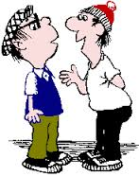
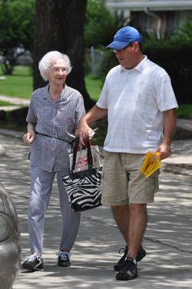
How to infer character traits:
Look at:
“I am so much better than you!”
APPEARANCE
DIALOGUE
ACTIONS
This woman cares about her looks, she takes time to dress nice, do her hair, and do touch ups during the day.
This guy is clearly self-centered, seeing as he is overtly stating that he is better than his friend.
This man is a kind man because he takes the time to help an old woman across the street.

Slide 3
Scoring Inferences
1- Rainsford is a main character in the story.
2- Rainsford is an expert hunter.
3- Rainsford dramatically changes in the texts.
4- Rainsford dramatically changes over the course of the text, from selfish and arrogant to empathetic.

Slide 4
Make your own inferences
LT: I can analyze a the make inferences about characters and support them with textual evidence.
1st- Read “Thank You M’am” as a class (pg 108)
2nd- Individually or with a partner, choose a character to analyze. What traits can you infer about the character? Make a chart in your notebook like the one below. You must make at least three inferences use at least one direct quote from the text!!!
Trait/Inference
Actions and/or Dialogue that lead me to this inference:

